Slide 1
Logistic Regression on Categorical Data using Sigmoid or Logistic Function

Slide 2
Linear Regression – Linear Function for Continuous variables
Examples - Home Price, Stock Price
Logistic Regression - Sigmoid or Logistic Function for Categorical variables
Examples - Game Win, Covid Test, Risk (Low, Mid or High)
Classification Type:
Binary: Would we win this game (Yes/No).
MultiClass: How much would be the risk - Low, Medium or High.
Logistic Regression is the technique used for classification problems.

Slide 3
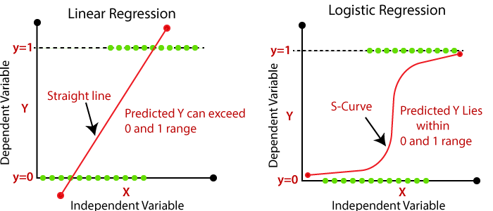

Slide 4
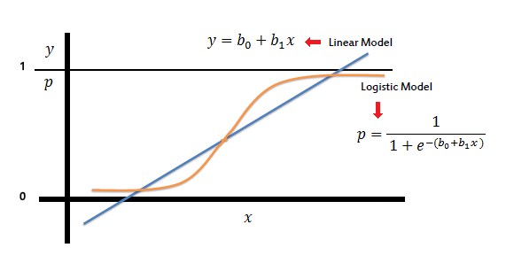
Sigmoid/Logistic Function derived from Linear Function

Slide 5
Feature Variable = Independent = X variable
Target Variable = Dependent = Y variable
Assumptions of Linear Regression
Linear relationship - Target & Feature relationship is linear and additive.
No or little multicollinearity - Variables are independent of each another.
Homoscedasticity of errors - constant variance
Errors are normally distributed
No auto-correlation

